Slide 1
ACEC RT 2022 Market and Economic Forecast Webinar
John Pickett and Brent Hartman

Slide 2
The ACEC Retirement Trust Disclaimer
“ACEC is a Federally registered trademark of American Council of Engineering Companies Inc. (ACEC) and is used herein according to appropriate permissions of registrant. RT is a registered trademark of the ACEC Retirement Trust which is a separate entity from the American Council of Engineering Companies Inc. (ACEC).”
ACEC RT 2022 Market and Economic Forecast Webinar

Slide 3
About This Webinar
IT IS NOT:
A prediction of how the market will do in 2022
“Those who have knowledge, don’t predict. Those who predict, don’t have knowledge.” – Lao Tzu Chinese Philosopher born 571 BCE
A place to get stock-picking advice
IT IS:
A place to understand the macro drivers of the economy and capital markets
A place to learn more about your retirement plan
A place to evaluate your retirement goals, objectives, risk tolerance, and potential timeline
ACEC RT 2022 Market and Economic Forecast Webinar

Slide 4
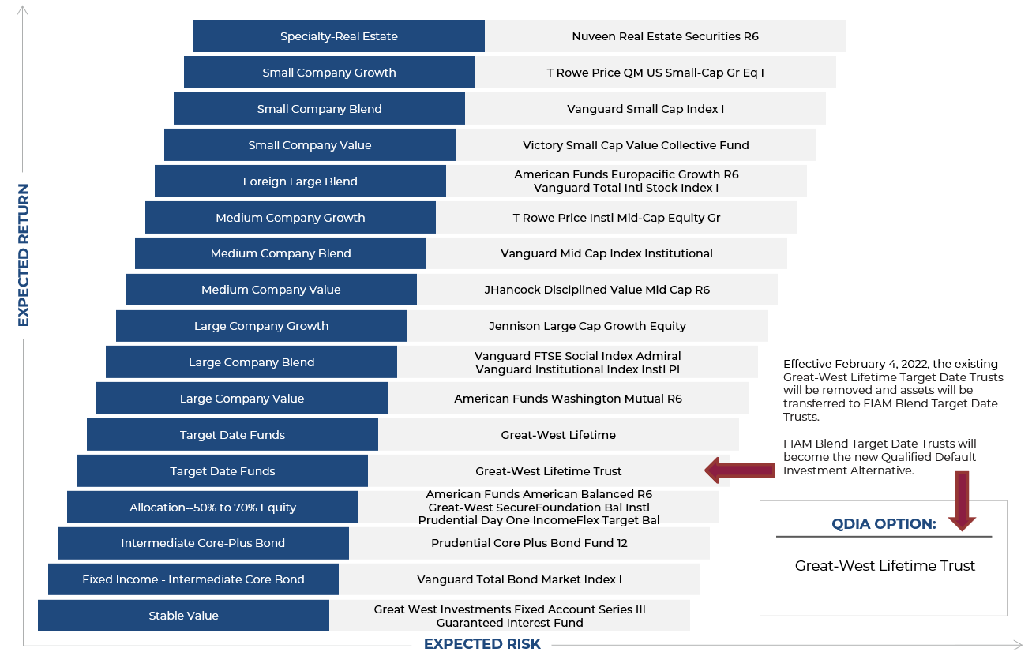
Plan Investment Review – Plan Menu
ACEC RT 2022 Market and Economic Forecast Webinar

Slide 5
Choppy Quarter Caps Stellar Year for U.S. Stocks
Despite bouts of volatility fueled by virus and policy uncertainty, supply chain woes, and inflation worries, most asset classes posted solid returns in 2021, led by economically sensitive sectors that benefitted from reopening trends. Emerging markets stocks were roiled by China policy and growth concerns, and core bonds moved sideways as bond yields ticked modestly higher.
U.S. large-cap stocks delivered solid returns for the quarter and finished 2021 with a gain of nearly 29% for a third consecutive year of outsized returns. Small-cap stocks lagged their large-cap peers but still posted double-digit returns.
International developed market stocks also posted healthy returns for the year, even as China risks cast a dark cloud over emerging markets.
Fueled by a rebound in oil prices, commodities advanced by more than 27% for the year despite a fourth-quarter pullback amid rapid spread of the omicron variant.
Public real estate added to gains in the fourth quarter despite continued virus concerns, following steady advances over the course of the year.
Core bonds treaded water in the fourth quarter (and the full year), as bond yields shrugged off inflation concerns with only a modest uptick.
Emerging Market Stocks
U.S. Bonds
Developed
International Stocks
U.S. Small-Cap Stocks
Commodities
U.S. Large-Cap Stocks
Real Estate
Q4 2021
YTD 2021
Asset class returns are represented by the following indexes: Bloomberg Barclays U.S. Aggregate Bond Index (U.S. bonds), S&P 500 Index (U.S. large-cap stocks), Russell 2000® (U.S. small-cap stocks), MSCI EAFE Index (international developed market stocks), MSCI Emerging Market Index (emerging market stocks), Dow Jones U.S. Real Estate Index (real estate), and Bloomberg Commodity Index (commodities).
ACEC RT 2022 Market and Economic Forecast Webinar

Slide 6
S&P 500 Historical Annual Returns
ACEC RT 2022 Market and Economic Forecast Webinar

Slide 7
What Is Changing in 2022?
Fiscal and monetary policy – accommodative to neutral
Inflation – here to stay or transitory?
Shifting political environment
Increasing geopolitical risks – Russia/Ukraine and China/Taiwan
Health of businesses
Health of consumers
ACEC RT 2022 Market and Economic Forecast Webinar

Slide 8
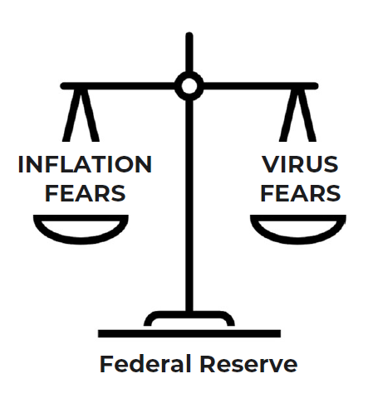
Current Conditions
Peak Policy Risk
Although the Fed has so far stressed patience in policy tapering and tightening until the labor market fully heals, rising inflationary pressures may force its hand.
“At this point the economy is very strong and inflation pressures are high…it is therefore appropriate in my view to consider wrapping up the taper of our asset purchases… perhaps a few months sooner.”
Federal Reserve Chairman Jerome Powell, 11.30.2021
Growing concerns around the Omicron variant may muddy the path of Fed and fiscal policy. While each successive virus wave has had less economic impact than the one before, a significant virus mutation could threaten the trajectory of the economic recovery.
The Fed must balance taking its foot off the monetary policy accelerator to relieve near-term inflation pressures, while maintaining tools to manage longer term threats. This could mean faster tapering to ease inflation fears, along with more flexibility on future rate hikes to help navigate future uncertainty.
Meanwhile, the fundamental economic picture remains strong, supported by:
Wealthy consumer = healthy demand
Recovering (but injured) supply chains
Strong and improving employment picture
Record profits supporting CapEx investments
ACEC RT 2022 Market and Economic Forecast Webinar

Slide 9
Investment Committee Dashboard – Dec. 1, 2021
ACEC RT 2022 Market and Economic Forecast Webinar

Slide 10
Digging Deeper: U.S. Equity Markets
The S&P 500 Index is a market-capitalization-weighted index of U.S. large-cap stocks across a diverse set of industry sectors. The stocks represented in these 11 sectors generated a range of returns for the last 12 months and the most recent quarter.
Returns by S&P 500 Sector
S&P 500 Index
Technology
Consumer Discretionary
Financials
Communication Services
Industrials
Consumer Staples
Real Estate
Energy
Materials
Utilities
Health Care
Sector Weight | 29.2% | 13.3% | 12.5% | 10.7% | 10.2% | 7.8% | 5.9% | 2.8% | 2.7% | 2.6% | 2.5%
ACEC RT 2022 Market and Economic Forecast Webinar

Slide 11
Wage Inflation for (Some) Workers
U.S. workers’ wages are growing at their fastest pace in 20 years as companies compete for workers in a tight labor market. The number of job openings has reached historic levels, and the share of firms unable to fill positions has increased to record highs. However, labor force participation has yet to recover from the pandemic, forcing businesses to offer higher pay, bonuses, and other perks to induce workers to return.
Observations
While year-over-year wage levels across all private industries grew by 3.5%, the effects have been uneven. Food service workers saw wages rise at nearly twice the overall average.
Staffing shortages are particularly acute in the service industries hardest hit by the pandemic, including leisure and hospitality, as well as critical sectors such as transportation and health care.
The quit rate—or the share of workers who voluntarily leave their jobs—has traditionally been highest in lower-wage service sector jobs. Now, quit rates are on the rise as existing staff bear the brunt of staffing shortages, while rising wages promote job hopping.
Wage gains are important to raise living standards and help close the income gap. But unlike other business input costs, wages tend not to decline, increasing the risks of more persistent inflation.
Wage Increases and Quit Rates by Occupation Group (Year over Year, June 2021)
All Private Industry Workers | All Public Government Workers | Food Services | Leisure and Hospitality | Shipping, Transportation & Warehousing | Nursing / Health Care Facilities
ACEC RT 2022 Market and Economic Forecast Webinar

Slide 12
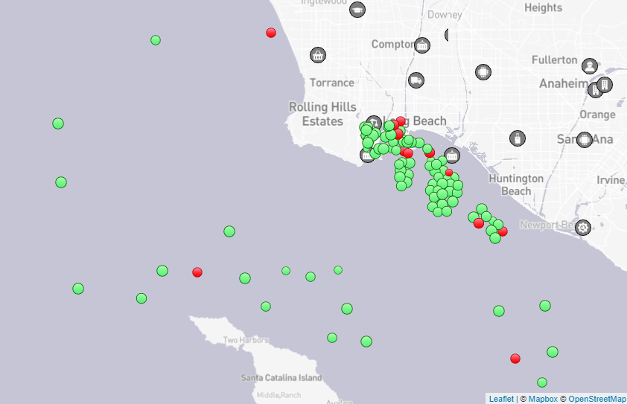
A Global Logistics Logjam
Each year, an estimated 225 million steel cargo containers traverse the world’s oceans. But as the complex machinery of a highly interconnected global economy struggles to return to full speed following the pandemic, severe bottlenecks have emerged, leading to shipping delays, bare store shelves, parts and material shortages, and rising prices that threaten to exacerbate inflation pressures.
Shipping Price per 40-Foot Container
Ships at Anchor—Port of Los Angeles/Long Beach
OBSERVATIONS
An important driver of globalization has been low and stable freight prices. But as shown above, the price of moving a 40-foot container from China to the U.S. has spiked eight-fold just as we enter the pre-holiday inventory-restocking season. Rates for westbound freight haven’t followed suit, leading some ships to return empty and causing stranded containers to pile up at U.S. ports and railyards.
Crowded ports remain a significant bottleneck. The map above shows a record number of ships waiting at anchor at the vital port of Los Angeles/Long Beach as wait times to offload cargo stretch beyond a week.
Obstacles remain after freight reaches shore. A shortage of truck drivers—expected to reach 100,000 by 2023—has prompted proposals to lower the minimum age for interstate truck drivers from 21 to 18. In September, FedEx turned to technology to boost capacity as it launched a pilot program to haul packages between Houston and Dallas with self-driving trucks.
ACEC RT 2022 Market and Economic Forecast Webinar

Slide 13
Household Wealth Surge
Propelled by soaring stock and real estate markets and stimulus checks, U.S. households’ net worth has reached record highs. The Federal Reserve estimates that household net worth grew to nearly $142 trillion during the second quarter, with a $3.5 trillion gain in the value of equities, a $1.2 trillion jump in real estate values, and a $2.9 trillion gain in private savings. While ballooning wealth provides momentum for strong consumer spending, not everyone has benefitted from gains, raising concerns around wealth inequality and calls for tax reform.
Household Net Worth (in $ Trillions)
Tappable Home Equity (in $ Trillions)
OBSERVATIONS
Alongside significant gains in financial and real estate assets, consumers have also accumulated massive amounts of cash in checking and savings accounts. Given low or nonexistent interest rates on savings, these balances represent an enormous war chest for continued consumer spending and investing.
As home prices have soared—fueled by low mortgage rates, limited supply, and growing demand—the amount of home equity available to homeowners has risen above $9 trillion. This tappable equity represents the amount available in excess of the normal 20% equity requirement for most conventional mortgages and is an important source of funds for consumer spending and new business formation.
ACEC RT 2022 Market and Economic Forecast Webinar

Slide 14
Productivity Drives Margins Higher
Despite the significant disruptions caused by COVID-19, U.S. companies have delivered impressive financial results through cost-cutting measures and enhanced productivity, driving profit margins to record highs. Although firms now face headwinds as input and labor costs rise, economic conditions remain supported by strong consumer demand, business investment, and an extended inventory restocking cycle.
Observations
During the initial pandemic shock, corporate earnings and profit margins collapsed due to the unprecedented economic shutdown.
Aided by record levels of fiscal stimulus and low borrowing costs, businesses adapted with technology and operational efficiencies, driving productivity higher. Firms realized these benefits, generating record profits during the vaccine-fueled rebound.
Stock prices reflect both future growth expectations and current operating results. Although last year’s rally was fueled by optimism, this year’s gains have been driven by fundamentals, allowing stocks to grow into the lofty price levels reached last year.
For this upward trend to continue, firms must successfully navigate a range of cost and supply-side pressures that pose risks to future profit margins.
S&P 500 Index: Operating Margins and Forward Earnings
Sources: Bloomberg; CAPTRUST Research
ACEC RT 2022 Market and Economic Forecast Webinar

Slide 15
Economic Outlook
Markets in 2021 were propelled by a strong but bumpy reacceleration of economic activity. Although fundamentals remain in place for continued, albeit moderating, growth, investors continue to weigh a range of risks that will shape the markets’ next phase.
HEADWINDS
TAILWINDS
Variants Raise Specter of Winter Surge
New virus variants continue to rattle markets. Omicron represents an uncertain threat given reports of high transmissibility. However, given its milder symptoms, this could also mark the beginning of COVID-19’s transition from pandemic to endemic.
As Inflation Fears Mount…
The November Consumer Price Index (CPI ) reached a 40-year high level of 6.8%. Although skewed by outliers in categories such as energy and transportation, robust demand, supply constraints, and rising wages and housing costs suggest more persistent inflationary pressures may be ahead.
…Central Bank Hawks Kettle
The Federal Reserve has joined other global central banks in emphasizing inflation risks in statements on future policy. In December, it doubled the pace of tapering its asset purchases, paving the way for rate hikes in 2022.
The pace of tightening will be driven by how sticky inflation is relative to virus threats and labor conditions. This raises the risks of policy error if the Fed acts too soon—or waits too long.
Buying Power
The consumer is the engine of the global economy, and U.S. household balance sheets are uncommonly strong following several years of asset price gains, lower costs, and stimulus checks. The result is trillions of dollars in excess savings that will buoy demand into 2022.
Strong Fundamentals
Corporate profit margins exploded in 2021 as pandemic-driven cost-containment measures met a surge of pent-up demand, resulting in an estimated 45% pop in S&P 500 earnings—far in excess of the 5% average growth seen over the past decade.
Even as earnings growth returns to earth and input costs rise, easing supply chains and an extended inventory restocking cycle bode well for continued above-trend earnings growth.
Tight Labor Markets Push Wages Higher
Rising wages will help fill the gap left by the winding down of government stimulus, particularly as inflation pressure falls. A combination of higher pay, pandemic progress, and fewer childcare constraints could entice workers sidelined by the pandemic back to the workplace.
Following a third year of outsized equity returns, investors should not be complacent. Although fundamentals remain strong, the global economy now faces a risky transition as exceptional stimulus fades into a tighter policy environment even as virus risks remain.
ACEC RT 2022 Market and Economic Forecast Webinar

Slide 16
Household Wealth Surge Sustains Growth
Despite the personal and economic trauma caused by the COVID-19 pandemic, U.S. household wealth swelled by nearly $30 trillion since the end of 2019 through the combination of massive fiscal support and stimulus programs and surging asset prices. Although the direct impacts of fiscal stimulus are now fading, solid wage growth will provide further support to household balance sheets in 2022 and beyond.
Observations
Consumer balance sheets have never been stronger. Household wealth surged over the past two years, propelled by financial and real estate asset prices and elevated savings rates.
Importantly, wealth gains have been spread across income bands, given the significant impact of stimulus checks, extended unemployment benefits, and rising wages.
Although the post-pandemic surge in pent-up demand for goods may be behind us, higher levels of U.S. household wealth and income will continue to provide significant support to the economy.
Shrinking loan balances represent another reservoir of future spending power as households have steadily de-levered following the global financial crisis.
Household Assets, Liabilities, and Net Worth (as a % of Disposable Income)
Sources: U.S. Federal Reserve, U.S. Bureau of Economic Analysis, Federal Reserve Bank of St. Louis
ACEC RT 2022 Market and Economic Forecast Webinar

Slide 17
Inflation: Looking Past the Headlines
The Consumer Price Index (CPI) posted a shocking 6.8% year-over-year change in November, the highest reading since 1982, quickly prompting a pivot by the Federal Reserve as it begins to tighten policy. However, a closer look at the latest CPI reading reveals that price pressures remain uneven, largely isolated within categories most disrupted by the pandemic.
Observations
A subset of categories tightly linked to the economic reopening—such as fuel and energy—along with categories most affected by supply chain problems (such as autos) has driven most of the inflation pressure this year.
Despite alarming levels of headline inflation, market-based measures remain more sanguine. Treasury yields have barely budged, and the 10-year breakeven rate—the average level of inflation expected by investors over the next decade—remains well below 3%.
A key aspect of whether inflation is temporary or a stickier, 1970s-style problem is how it alters consumer behaviors. So far, consumers appear unfazed.
A recent survey suggests consumers expect inflation to settle at 3% over the next five years, even given the historical tendency of such surveys to overestimate inflation’s future path.
November CPI by Category
Categories representing 14% of CPI weight… …drove 55% of the CPI increase
All Other
All Other
All Other
Consumer Price Index - November 2021 Year-over-Year Change (in %)
November CPI = 6.8%
Sources: U.S. Bureau of Labor Statistics, Bloomberg; CAPTRUST Research
ACEC RT 2022 Market and Economic Forecast Webinar

Slide 18
Tight Labor Market Drives Wages Higher
Propelled by soaring stock and real estate markets and stimulus checks, U.S. households’ net worth has reached record highs. The Federal Reserve estimates that household net worth grew to nearly $142 trillion during the second quarter, with a $3.5 trillion gain in the value of equities, a $1.2 trillion jump in real estate values, and a $2.9 trillion gain in private savings. While ballooning wealth provides momentum for strong consumer spending, not everyone has benefitted from gains, raising concerns around wealth inequality and calls for tax reform.
Household Net Worth (in $ Trillions)
Tappable Home Equity (in $ Trillions)
Observations
Alongside significant gains in financial and real estate assets, consumers have also accumulated massive amounts of cash in checking and savings accounts. Given low or nonexistent interest rates on savings, these balances represent an enormous war chest for continued consumer spending and investing.
As home prices have soared—fueled by low mortgage rates, limited supply, and growing demand—the amount of home equity available to homeowners has risen above $9 trillion. This tappable equity represents the amount available in excess of the normal 20% equity requirement for most conventional mortgages and is an important source of funds for consumer spending and new business formation.
ACEC RT 2022 Market and Economic Forecast Webinar

Slide 19
Talking About Tapering and Tightening
In December, the U.S. Federal Reserve abruptly shifted its tone from one of patience while the labor market fully recovers to heightened wariness of inflation pressures. Given the outsized influence of monetary policy on asset prices and growth conditions, investors are wise to pay close attention to the Fed’s comments and actions. Shifting gears on policy priorities also creates heighted risk of a policy error, if the Fed either tightens too soon and too fast or waits too long.
Observations
To accomplish its dual mandate of maintaining maximum employment and price stability, the Fed relies on two primary tools: changes to the fed funds rate and the size and composition of its balance sheet.
Less traditional tools, such as credit and liquidity facilities, are also available in times of stress.
After slashing its discount rate to zero at the onset of the COVID-19 crisis, the Fed returned to its crisis playbook and began gobbling up Treasury and mortgage bonds at a $120 billion per month clip to lower financing costs, loosen financial conditions, and spur demand.
Now, with the economy expanding at a faster-than-expected rate and inflation fears rising, the Fed announced a swifter conclusion to this program. Its planned $30 billion/month taper is a much faster pace than following the global financial crisis and paves the way for rate hikes next year if inflation concerns persist.
Federal Reserve Balance Sheet and Fed Funds Rate
Global Financial
Crisis
COVID-19
Pandemic
Sources: St. Louis Federal Reserve Bank; CAPTRUST Research
ACEC RT 2022 Market and Economic Forecast Webinar

Slide 20
S&P 500 Index: Forward P/E Ratio
+1 Std Dev: 20.6x
Current: 22.1x
25-Year Average: 17.2x
-1 Std Dev: 13.7x
Valuation Measure | Description | Latest | 25-Year Average | Std Dev Over-/Under-Valued | Inception Year
P/E | Forward P/E | 22.1x | 17.2x | 1.4x | 1996
CAPE | Shiller’s P/E | 39.6 | 28.0 | 1.8 | 1996
Div. Yield | Dividend Yield | 1.4% | 2.0% | -2.2 | 2006
P/B | Price to Book | 4.9 | 3.1 | 2.2 | 1996
P/CF | Price to Cash Flow | 15.7 | 10.6 | 2.1 | 2006
Sources: Bloomberg, Robert Shiller, NASDAQ, CAPTRUST Research. Price-to-earnings (P/E) ratio is price divided by consensus analyst estimates of earnings per share for the next 12 months provided by Bloomberg. Average P/E and standard deviations are calculated using 25 years of history. Shiller’s P/E uses trailing 10 years of inflation-adjusted earnings as reported by companies. Dividend yield is calculated as the current year's consensus dividend divided by the most recent price. Price-to-book (P/B) ratio is the price divided by book value per share. Price-to-cash-flow (P/CF) ratio is the price divided by cash flow for the next 12 months. Standard deviation over-/undervalued is calculated using the average and standard deviation for each measure.
ACEC RT 2022 Market and Economic Forecast Webinar

Slide 21
asset class returns
2008 | 2009 | 2010 | 2011 | 2012 | 2013 | 2014 | 2015 | 2016 | 2017 | 2018 | 2019 | 2020 | 2021
Fixed Income 5.08% | Mid-Cap Growth 46.29% | Small-Cap Growth 29.09% | Fixed Income 7.84% | Mid-Cap Value 18.51% | Small-Cap Growth 43.30% | Mid-Cap Value 14.75% | Large-Cap Growth 5.67% | Small-Cap Value 31.74% | Large-Cap Growth 30.21% | Cash 1.87% | Large-Cap Growth 36.39% | Large-Cap Growth 38.49% | Mid-Cap Value 28.34%
Cash 1.51% | Large-Cap Growth 37.21% | Mid-Cap Growth 26.38% | Large-Cap Growth 2.64% | Small-Cap Value 18.05% | Mid-Cap Growth 35.74% | Large-Cap Value 13.45% | Fixed Income 0.55% | Mid-Cap Value 20.00% | International Equities 25.62% | Fixed Income 0.01% | Mid-Cap Growth 35.47% | Mid-Cap Growth 35.59% | Small-Cap Value 28.27%
Small-Cap Value -28.92% | Small-Cap Growth 34.47% | Mid-Cap Value 24.75% | Large-Cap Value 0.39% | International Equities 17.90% | Small-Cap Value 34.52% | Large-Cap Growth 13.05% | Cash 0.05% | Large-Cap Value 17.34% | Mid-Cap Growth 25.27% | Large-Cap Growth -1.51% | Small-Cap Growth 28.48% | Small-Cap Growth 34.63% | Large-Cap Growth 27.60%
Large-Cap Value -36.85% | Mid-Cap Value 34.21% | Small-Cap Value 24.50% | Cash 0.10% | Large-Cap Value 17.51% | Large-Cap Growth 33.48% | Mid-Cap Growth 11.90% | Mid-Cap Growth -0.20% | Small-Cap Growth 11.32% | Small-Cap Growth 22.17% | Mid-Cap Growth -4.75% | Mid-Cap Value 27.06% | International Equities 8.28% | Large-Cap Value 25.16%
Mid-Cap Value -38.44% | International Equities 32.46% | Large-Cap Growth 16.71% | Mid-Cap Value -1.38% | Mid-Cap Growth 15.81% | Mid-Cap Value 33.46% | Fixed Income 5.97% | International Equities -0.39% | Mid-Cap Growth 7.33% | Large-Cap Value 13.66% | Large-Cap Value -8.27% | Large-Cap Value 26.54% | Fixed Income 7.51% | Mid-Cap Growth 12.73%
Large-Cap Growth -38.44% | Small-Cap Value 20.58% | Large-Cap Value 15.51% | Mid-Cap Growth -1.65% | Large-Cap Growth 15.26% | Large-Cap Value 32.53% | Small-Cap Growth 5.60% | Small-Cap Growth -1.38% | Large-Cap Growth 7.08% | Mid-Cap Value 13.34% | Small-Cap Growth -9.31% | International Equities 22.66% | Mid-Cap Value 4.96% | International Equities 11.78%
Small-Cap Growth -38.54% | Large-Cap Value 19.69% | International Equities 8.21% | Small-Cap Growth -2.91% | Small-Cap Growth 14.59% | International Equities 23.29% | Small-Cap Value 4.22% | Large-Cap Value -3.83% | Fixed Income 2.65% | Small-Cap Value 7.84% | Mid-Cap Value -12.29% | Small-Cap Value 22.39% | Small-Cap Value 4.63% | Small-Cap Growth 2.83%
International Equities -43.06% | Fixed Income 5.24% | Fixed Income 5.89% | Small-Cap Value -5.50% | Fixed Income 4.22% | Cash 0.07% | Cash 0.03% | Mid-Cap Value -4.78% | International Equities 1.51% | Fixed Income 3.54% | Small-Cap Value -12.86% | Fixed Income 8.72% | Large-Cap Value 2.80% | Cash 0.05%
Mid-Cap Growth -44.32% | Cash 0.21% | Cash 0.13% | International Equities -11.73% | Cash 0.11% | Fixed Income -2.02% | International Equities -4.48% | Small-Cap Value -7.47% | Cash 0.33% | Cash 0.86% | International Equities -13.36% | Cash 2.28% | Cash 0.67% | Fixed Income -1.54%
Source: Markov Processes, Inc., Bloomberg, Mobius
 | Small-Cap Value Stocks (Russell 2000 Value) |  | Large-Cap Value Stocks (Russell 1000 Value) |  | International Equities (MSCI EAFE)
 | Small-Cap Growth Stocks (Russell 2000 Growth) |  | Mid-Cap Growth Stocks (Russell Mid-Cap Growth) |  | Fixed Income (Bloomberg Barclays U.S. Aggregate Bond)
 | Large-Cap Growth Stocks (Russell 1000 Growth) |  | Mid-Cap Value Stocks (Russell Mid-Cap Value) |  | Cash (Merrill Lynch 3-Month Treasury Bill)
The information contained in this report is from sources believed to be reliable but is not warranted by CAPTRUST to be accurate or complete.

Slide 22
Index Performance
INDEXES | 2021 | YTD | 2020 | 2019 | 2018 | 2017 | 2016 | 1 YEAR | 3 YEARS | 5 YEARS | 10 YEARS
90-Day U.S. Treasury | 0.01% | 0.05% | 0.67% | 2.28% | 1.87% | 0.86% | 0.33% | 0.05% | 0.99% | 1.14% | 0.63%
Bloomberg Barclays Government 1-3 Year | -0.58% | -0.60% | 3.14% | 3.59% | 1.58% | 0.45% | 0.87% | -0.60% | 2.03% | 1.62% | 1.10%
Bloomberg Barclays Intermediate Govt | -0.58% | -1.69% | 5.73% | 5.20% | 1.43% | 1.14% | 1.05% | -1.69% | 3.02% | 2.32% | 1.68%
Bloomberg Barclays Muni Bond | 0.72% | 1.52% | 5.21% | 7.54% | 1.28% | 5.45% | 0.25% | 1.52% | 4.72% | 4.17% | 3.72%
Bloomberg Barclays Intermediate Govt/Credit | -0.57% | -1.44% | 6.43% | 6.80% | 0.88% | 2.14% | 2.08% | -1.44% | 3.86% | 2.91% | 2.38%
Bloomberg Barclays Intermediate Credit | -0.55% | -1.03% | 7.08% | 9.52% | 0.01% | 3.67% | 3.68% | -1.03% | 5.09% | 3.77% | 3.53%
Bloomberg Barclays Aggregate Bond | 0.01% | -1.54% | 7.51% | 8.72% | 0.01% | 3.54% | 2.65% | -1.54% | 4.79% | 3.57% | 2.90%
Bloomberg Barclays Corporate IG Bond | 0.23% | -1.04% | 9.89% | 14.54% | -2.51% | 6.42% | 6.11% | -1.04% | 7.59% | 5.26% | 4.69%
Bloomberg Barclays High Yield | 0.71% | 5.28% | 7.11% | 14.32% | -2.08% | 7.50% | 17.13% | 5.28% | 8.83% | 6.29% | 6.82%
Bloomberg Barclays Global Aggregate | -0.67% | -4.71% | 9.20% | 6.84% | -1.20% | 7.39% | 2.09% | -4.71% | 3.59% | 3.36% | 1.77%
Bloomberg Barclays U.S. Long Corporate | 1.47% | -1.13% | 13.94% | 23.89% | -7.24% | 12.09% | 10.97% | -1.13% | 11.75% | 7.73% | 6.54%
S&P 500 | 11.03% | 28.71% | 18.40% | 31.49% | -4.38% | 21.83% | 11.96% | 28.71% | 26.06% | 18.46% | 16.54%
Dow Jones Industrial Average | 7.87% | 20.95% | 9.72% | 25.34% | -3.48% | 28.11% | 16.50% | 20.95% | 18.48% | 15.51% | 14.20%
NASDAQ Composite | 8.28% | 21.39% | 43.64% | 35.23% | -3.88% | 28.24% | 7.50% | 21.39% | 33.09% | 23.77% | 19.62%
Russell 1000 Value | 7.77% | 25.16% | 2.80% | 26.54% | -8.27% | 13.66% | 17.34% | 25.16% | 17.64% | 11.16% | 12.96%
Russell 1000 | 9.78% | 26.45% | 20.96% | 31.43% | -4.78% | 21.69% | 12.05% | 26.45% | 26.20% | 18.41% | 16.53%
Russell 1000 Growth | 11.64% | 27.60% | 38.49% | 36.39% | -1.51% | 30.21% | 7.08% | 27.60% | 34.07% | 25.30% | 19.77%
Russell Mid-Cap Value Index | 8.54% | 28.34% | 4.96% | 27.06% | -12.29% | 13.34% | 20.00% | 28.34% | 19.62% | 11.21% | 13.43%
Russell Mid-Cap Index | 6.44% | 22.58% | 17.10% | 30.54% | -9.06% | 18.52% | 13.80% | 22.58% | 23.28% | 15.09% | 14.89%
Russell Mid-Cap Growth Index | 2.85% | 12.73% | 35.59% | 35.47% | -4.75% | 25.27% | 7.33% | 12.73% | 27.45% | 19.82% | 16.61%
MSCI EAFE | 2.74% | 11.78% | 8.28% | 22.66% | -13.36% | 25.62% | 1.51% | 11.78% | 14.07% | 10.06% | 8.53%
MSCI ACWI ex U.S. | 1.88% | 8.29% | 11.13% | 22.13% | -13.78% | 27.77% | 5.01% | 8.29% | 13.69% | 10.11% | 7.77%
Russell 2000 Value | 4.36% | 28.27% | 4.63% | 22.39% | -12.86% | 7.84% | 31.74% | 28.27% | 17.99% | 9.06% | 12.02%
Russell 2000 | 2.14% | 14.82% | 19.96% | 25.52% | -11.01% | 14.65% | 21.31% | 14.82% | 20.02% | 12.01% | 13.22%
Russell 2000 Growth | 0.01% | 2.83% | 34.63% | 28.48% | -9.31% | 22.17% | 11.32% | 2.83% | 21.16% | 14.52% | 14.12%
MSCI Emerging Markets | -1.24% | -2.22% | 18.69% | 18.90% | -14.25% | 37.75% | 11.60% | -2.22% | 11.32% | 10.26% | 5.86%
Dow Jones U.S. Real Estate Index | 14.58% | 38.99% | -5.29% | 28.92% | -4.03% | 9.84% | 7.56% | 38.99% | 19.27% | 12.33% | 11.70%
HFRX Absolute Return Index | 0.27% | 2.10% | 2.72% | 4.37% | -0.49% | 3.39% | 0.31% | 2.10% | 3.06% | 2.40% | 2.04%
Consumer Price Index (Inflation) | 7.12% | 2.21% | 1.30% | 2.26% | 1.92% | 2.10% | 2.05% | 7.12% | 3.53% | 2.92% | 2.12%
BLENDED BENCHMARKS | 2021 | YTD | 2020 | 2019 | 2018 | 2017 | 2016 | 1 YEAR | 3 YEARS | 5 YEARS | 10 YEARS
25% S&P 500/5% MSCI EAFE/70% BB Agg | 2.87% | 6.13% | 10.87% | 14.96% | -1.55% | 8.93% | 5.00% | 6.13% | 10.59% | 7.72% | 6.66%
30% S&P 500/10% MSCI EAFE/60% BB Agg | 3.56% | 8.27% | 11.56% | 16.79% | -2.44% | 10.90% | 5.43% | 8.27% | 12.15% | 8.83% | 7.65%
35% S&P 500/15% MSCI EAFE/50% BB Agg | 4.25% | 10.44% | 12.18% | 18.63% | -3.34% | 12.90% | 5.85% | 10.44% | 13.70% | 9.91% | 8.63%
40% S&P 500/20% MSCI EAFE/40% BB Agg | 4.94% | 12.64% | 12.75% | 20.48% | -4.25% | 14.93% | 6.26% | 12.64% | 15.23% | 10.99% | 9.60%
45% S&P 500/25% MSCI EAFE/30% BB Agg | 5.63% | 14.87% | 13.25% | 22.33% | -5.17% | 16.99% | 6.65% | 14.87% | 16.75% | 12.04% | 10.56%
60% S&P 500/40% Bloomberg Barclays Agg | 6.57% | 15.86% | 14.73% | 22.18% | -2.35% | 14.21% | 8.31% | 15.86% | 17.54% | 12.62% | 11.14%
Sources: Morningstar Direct, MPI. The opinions expressed in this report are subject to change without notice. This material has been prepared or is distributed solely for informational purposes and is not a solicitation or an offer to buy any security or to participate in any investment strategy. The performance data quoted represents past performance and does not guarantee future results. Index averages are provided for comparison purposes only. The information and statistics in this report are from sources believed to be reliable but are not guaranteed to be accurate or complete. CAPTRUST is an investment adviser registered under the Investment Advisers Act of 1940.
ACEC RT 2022 Market and Economic Forecast Webinar
Notes:
1.24%
1.87%
0.86%
0.33%
0.05%
0.03%
2.31%
1.38%
0.87%
2.47%
1.58%
0.45%
0.87%
0.57%
0.64%
4.02%
1.31%
1.23%
3.96%
1.43%
1.14%
1.05%
1.18%
2.52%
6.15%
1.34%
1.94%
5.09%
1.28%
5.45%
0.25%
3.30%
9.05%
6.71%
2.55%
3.64%
4.97%
0.88%
2.14%
2.08%
1.07%
3.13%
6.93%
1.99%
2.39%
6.65%
0.01%
3.67%
3.68%
0.90%
4.16%
8.23%
3.01%
3.10%
6.11%
0.01%
3.54%
2.65%
0.55%
5.97%
7.87%
2.31%
2.95%
9.85%
-2.51%
6.42%
6.11%
-0.68%
7.46%
10.72%
3.94%
4.08%
9.94%
-2.08%
7.50%
17.13%
-4.47%
2.45%
7.48%
7.52%
4.70%
5.57%
-1.20%
7.39%
2.09%
-3.15%
0.59%
5.85%
1.62%
1.20%
18.54%
-4.38%
21.83%
11.96%
1.38%
13.69%
10.42%
14.19%
10.71%
15.40%
-3.48%
28.11%
16.50%
0.21%
10.04%
12.20%
16.80%
12.29%
20.66%
-3.88%
28.24%
7.50%
5.73%
13.40%
6.60%
18.24%
12.68%
16.24%
-8.27%
13.66%
17.34%
-3.83%
13.45%
8.46%
10.19%
7.46%
18.84%
-4.78%
21.69%
12.05%
0.92%
13.24%
10.02%
14.15%
10.45%
21.49%
-1.51%
30.21%
7.08%
5.67%
13.05%
11.56%
18.07%
13.39%
18.02%
-12.29%
13.34%
20.00%
-4.78%
14.75%
3.68%
8.95%
6.72%
21.35%
-9.06%
18.52%
13.80%
-2.44%
13.22%
7.83%
12.16%
8.63%
26.08%
-4.75%
25.27%
7.33%
-0.20%
11.90%
13.94%
16.49%
11.10%
14.49%
-13.36%
25.62%
1.51%
-0.39%
-4.48%
1.60%
9.65%
2.74%
14.00%
-13.78%
27.77%
5.01%
-5.25%
-3.44%
1.80%
9.91%
2.65%
13.47%
-12.86%
7.84%
31.74%
-7.47%
4.22%
-6.24%
9.81%
5.39%
16.98%
-11.01%
14.65%
21.31%
-4.41%
4.89%
-3.31%
12.30%
7.06%
20.36%
-9.31%
22.17%
11.32%
-1.38%
5.60%
-0.49%
14.69%
8.63%
10.78%
-14.25%
37.75%
11.60%
-14.60%
-1.82%
1.61%
11.06%
2.87%
19.21%
-4.03%
9.84%
7.56%
2.14%
27.24%
12.81%
6.37%
8.57%
1.66%
-0.49%
3.39%
0.31%
2.86%
0.79%
0.11%
1.69%
1.33%
1.93%
1.91%
2.11%
2.07%
0.73%
0.76%
1.63%
2.04%
1.45%

Slide 23
ACEC RT 2022 Market and Economic Forecast Webinar
Appendix

Slide 24
FIAM Blend Target Date
ACEC RT 2022 Market and Economic Forecast Webinar

Slide 25
FIAM Blend Target Date
ACEC RT 2022 Market and Economic Forecast Webinar

Slide 26
Target Date Analysis
ACEC RT 2022 Market and Economic Forecast Webinar

